Slide 1
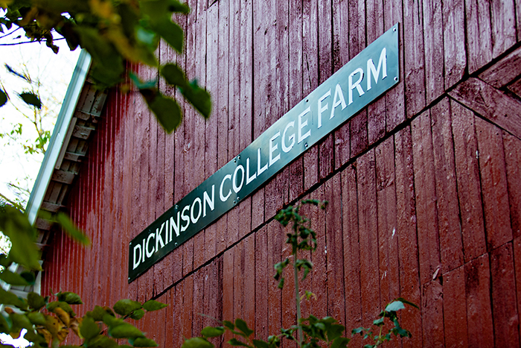
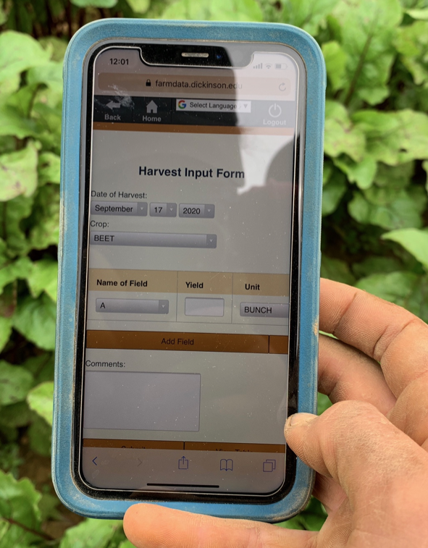
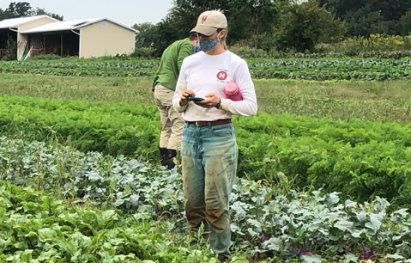
01 – Introduction and FarmData2 Install
COMP 290 – Dickinson College
Prof. Braught
Spring 2023

Slide 2
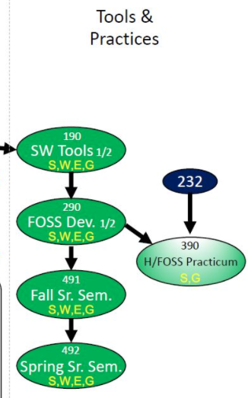
Curricular Context
Notes:
190…
- guided, detailed, building foundation, experience and skills
290
- You have those skills and experiences now.
- Shift to less specific more realistic experience of joining a project
- But with support of a class
- Provide experience of being part of a real project
- Real technologies, real tools, real users
- Similar to an internship or job experience in the classroom
- Great experience to tout in applying for internships
- If you are successful, will build GitHub resume too.
Preparation for 390 (if interested) and 491/492
- when you join and work on an H/FOSS project of interest
ALSO: S, W, E, G

Slide 3
290 Large-scale and Open Source Software Development
An introduction to large-scale software development through participation in a Humanitarian Free and Open Source Software (HFOSS) project. Readings and discussions will focus on FOSS and HFOSS philosophy, licensing, communication tools, project and community organization, and software engineering topics related to large-scale software development. Case studies of social, legal and ethical issues raised by computing and computing for the greater good will complement participation in the HFOSS project.
Notes:
Overarching goal is to have the experience of participating in a real-world project.
Real technologies, real tools, real clients and real users
That will be the central part of the course
- First half will be onboarding to the project
- learning the tools and technologies
- Improving independent leaning strategies for picking new things up on your own.
- Second half will be working in teams developing new features for the project.
Along with that…
- reading / discussions for breadth and perspective on FOSS and SWE
- readings for context (SLE / CGG)

Slide 4
COMP 290 – Course Mechanics
https://dickinson-comp290.github.io/website/
½ Credit
Credit / No Credit
Weekly Work
Reading and Discussion (social/legal/ethical)
Introductory Lecture
Activity Sheet (submit on Moodle)
Scored 0-3, Resubmits for 0-1 within 1 week of return.
~3 hours.
Collaborate but do not copy!
Communications
Moodle
Teams vs Zulip
GitHub
Notes:
Credit/No Credit – no letter grade.
- learn it because it is important!
Reading and Discussions
- Short ~10min readings and ~15 min discussion
- Come prepared to
- Say something about something you found interesting.
- Ask a question about the content
- Ask a question of your classmates (what did you think about xyz?)
- Not requiring you to post anything…
- but if its clear people are not reading and preparing, that will change
Introductory Lecture
- Big picture and context
- Not everything you need to know
Do overall course structure:
Web Site Schedule:
- FarmData2 and Web Development
- Learn how farmdata 2 works and how to contribute.
- Learn the basics of front-end web-development using FD2 technologies.
- Structured as hands-on activities – a lot like 190
- But with even more reliance on outside resources
- Moving you toward greater independent learning.
- Will require more ”figuring tings out” on your part.
- This is again, one of the main reasons that this course and 190 are CR/NC
- Project work
- Teams of 3-4 will work on contributions to the project.
- What those are will
- Rely on what you have learned.
- Depend upon what the project needs at the time.
- Final presentation of the work that your team has done.
Moodle is just where you will turn things in.
Teams is for discussion about the class.
Zulip is for discussion about things having to do with FD2
- Use Teams to ask about course stuff (meetings, due dates, etc)
- Use Zulip to ask about FD2 stuff
- Pretty much anything to do with installing, using, editing, contributing.
- Installation – use the Install Stream.
- Assignments – use the FarmData2 School stream.
- This is important because
- what you put in Zulip is a resource for the community.
- other developers, other users, future classes here and elsewhere.
- what you put in Teams, only we get to see.

Slide 5
COMP 190/290 Philosophy
The goal of these courses is to give you a set of experiences with important tools and techniques.
Not expected to master every detail
Remember “what” can be done
“How” it is done is easy to look up and reconstruct
Operate in incomplete information situations
Make mistakes
Practice figuring things out
Practice independent learning from external resources
Develop intuition for future situations
”Ohhh…. This seems like that thing that one time…”
Notes:
Not mastering every detail
- somewhat different than a normal course.
- so you are not expected to understand everything in the same way as a typical course.
- The idea is to experience a lot of things that will be useful to you in the future.
- You’ll need to use them over and over and over again until they are natural.
- We are not going to try to drill them in here.
- But what you want to do is remember what you’ve done, not necessarily how you did it.
- Once you know what you can do and remember that you’ve done it its easy to look up how to do it.
You won’t always have all of the information you need
- you’ll make mistakes
- you’ll get practice figuring them out.
- Practice learning from external resources
- Most assignments will refer you to other sources for the learning.
- I will give overviews and big picture
- you will get the details from on-line technical documentation and tutorials.
For both of these reasons this is a CR/NC course.
- Don’t want you memorizing commands and such
- Also don’t want to penalize you for working without complete information, when that’s what is expected.
By having lots of experience you develop an intuition about what is happening in future situations.
- Ohhhh yea… I’ve seen something like this before.
- What did do then?
- How did I do that?
Then once you do it a few dozen or a few hundred times, you’ll remember it.
So… bottom line…
- Don’t panic if you feel like you don’t understand everything deeply
- That is okay…
- This is about
- knowing “what” you can do
- having the experience of having done it
- being able to figure things out
- being able to look up “how” to do it again.

Slide 6
FarmData2
!
Notes:
Just a little refresher on FarmData2:
- FarmData2 - This is a Free and Open Source Software (FOSS) Project that we run here at Dickinson
- You saw FarmData2 in COMP190 and used it for a number of assignments.
- FarmData2 will be the centerpiece of this course.
- The overall goal of this course is to have you do work that advances the state of the FarmData2 project.
- We’ll just need to be sure we have the web development background that you need.

Slide 7
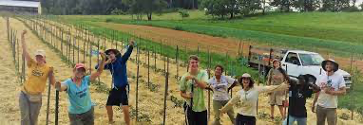
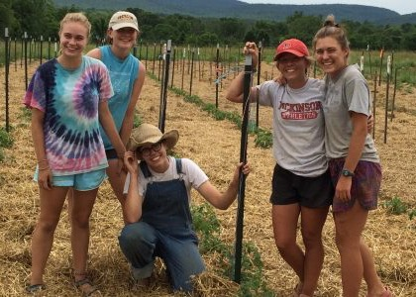
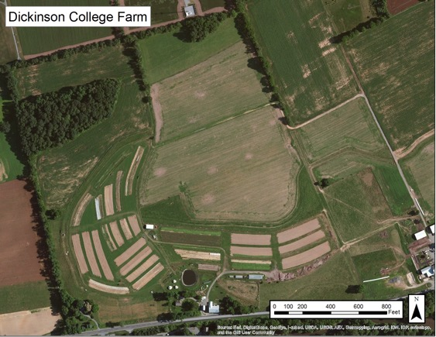
The Dickinson Farm
Dickinson’s College Farm is an 80-acre, USDA-certified organic farm and a living laboratory where students can gain distinctive, hands-on learning experiences.
Notes:
FarmData2 comes out of a collaboration with the Dickinson Farm.
If you haven’t been there
- We will take a trip to the farm a little later this semester to see how the farm operates
- learn a little about their processes and vocabulary
- meet the farmer that is helping us with the FarmData2 application.
- In encourage you to look for other opportunities to go for an event.

Slide 8
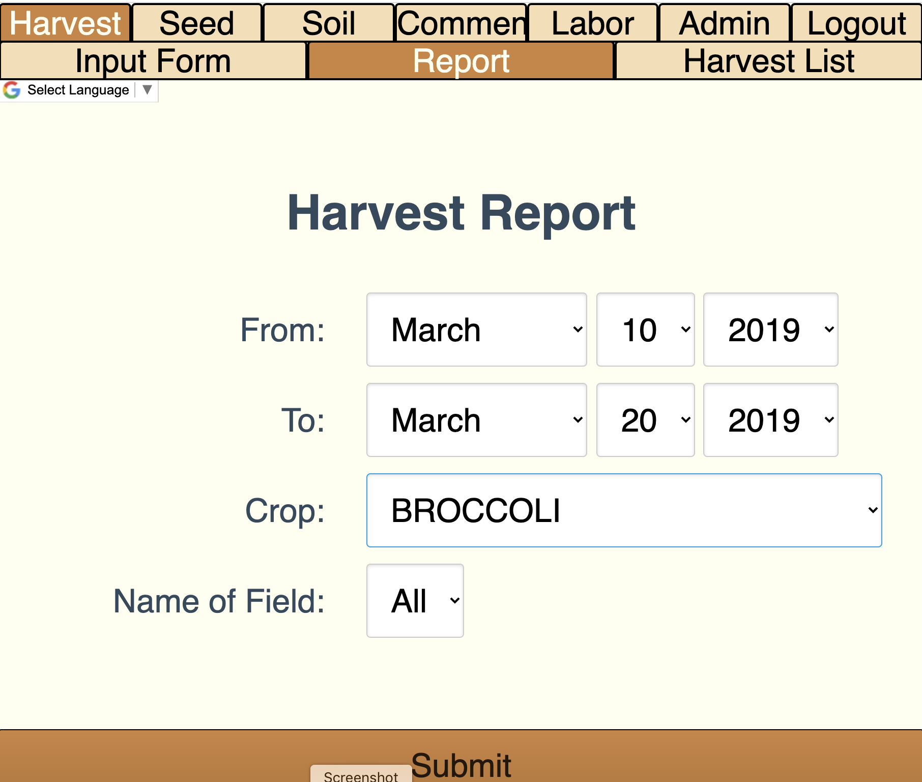
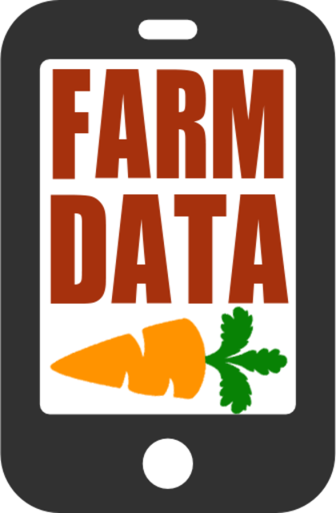
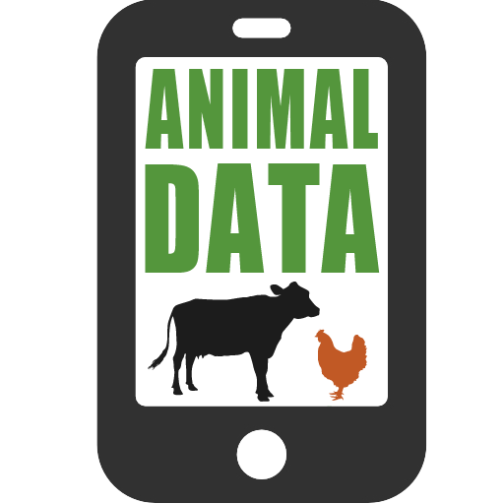
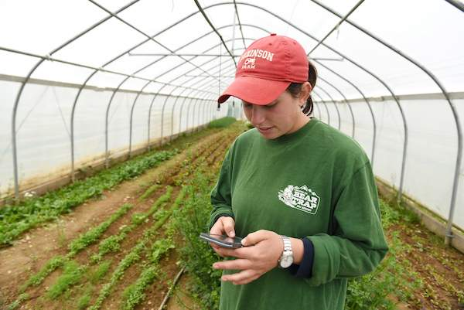
FarmData History:
Notes:
FarmData began in 2011 collaboration between Prof. Tim Wahls and Matt Steiman at the College Farm
Over 5 years
Led to the development of two applications
- FarmData and AnimalData
They are used:
- in the field on mobile devices to record data about harvests, growth, pest control, and a host of other things
- in the barn on desktop machines to plan harvests, track inventory and sales and to maintain records for organic certification.
2016 – We lost Prof. Wahls to cancer
- Development of FarmData and AnimalData stopped.
- But interest from the College Farm and other farms that are also using the FarmData app has remained.

Slide 9
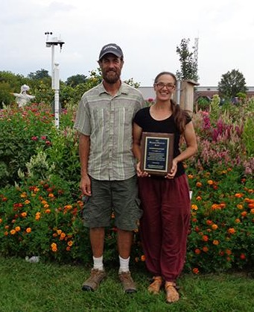
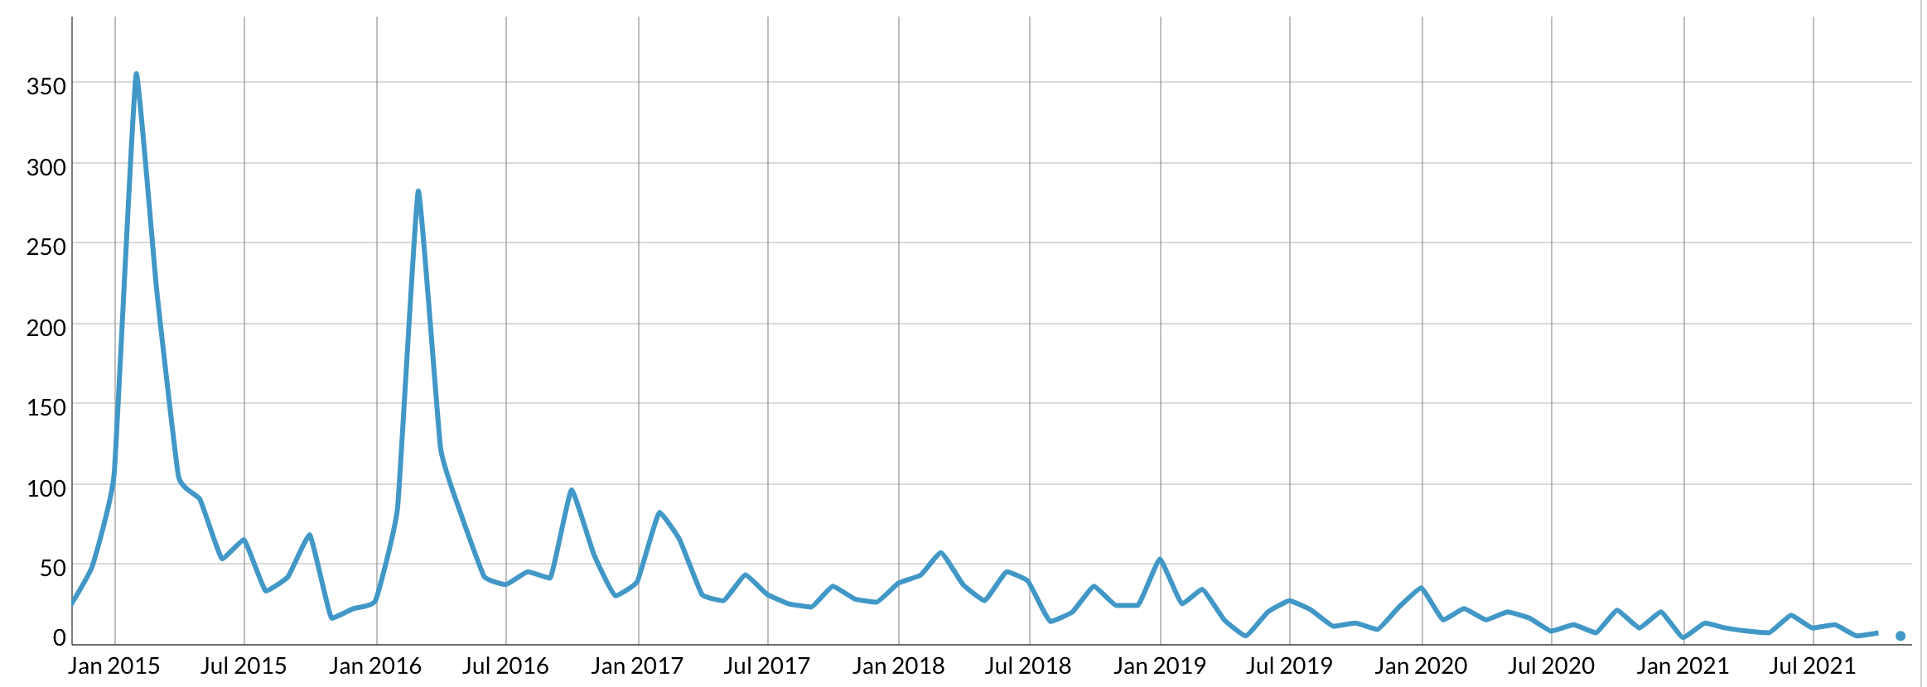
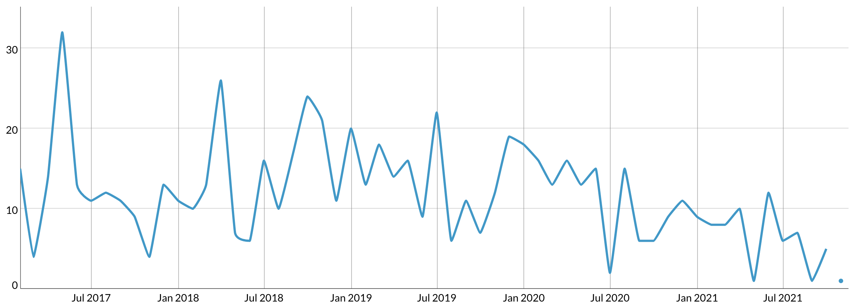
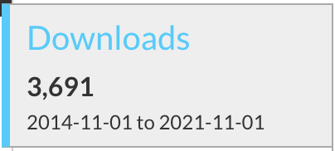
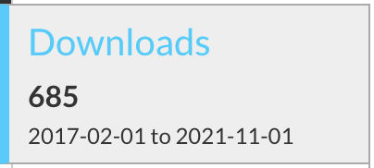
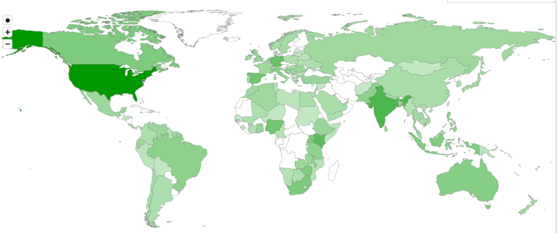
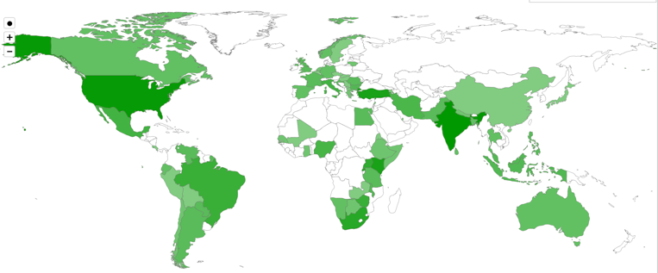
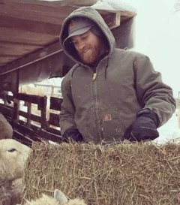
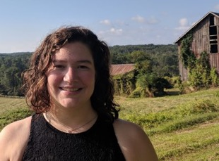
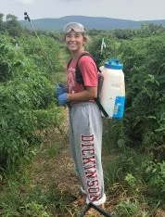
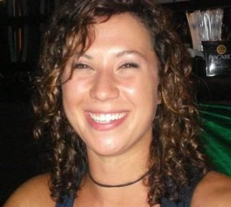
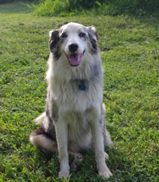
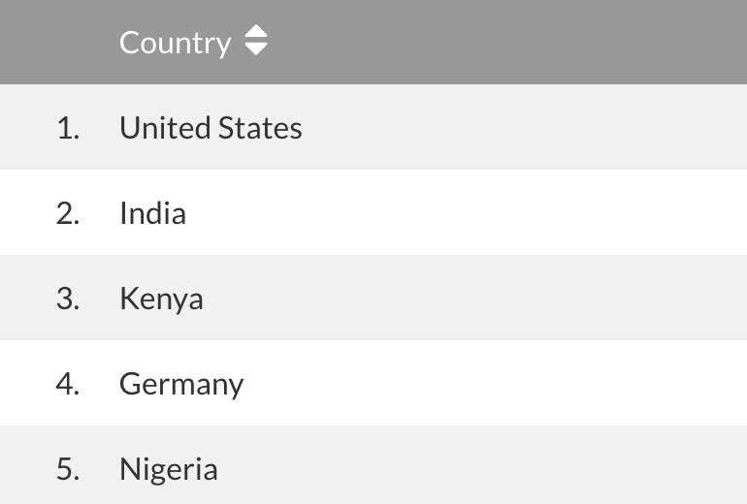
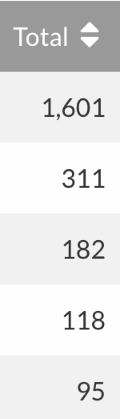
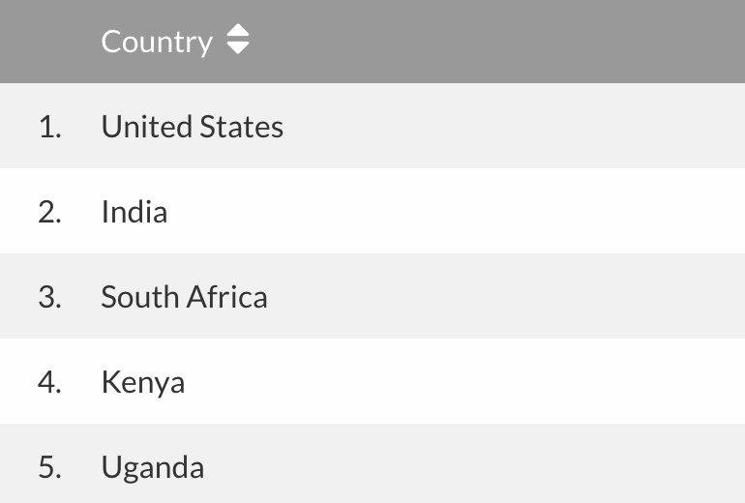
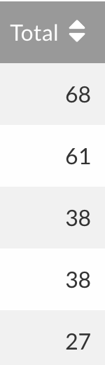
Local Clients, Global Communities
FarmData
AnimalData
Notes:
Matt (Farmer) & Jenn (Farm Manager)
- Some others from the farm.
- Tim and Matt talked about the application at a variety of conferences
- Raised awareness of it
- Don’t know how many active users there are
- but it’s been downloaded quite a number of times
- and all over the world.
This is data from November 2021.

Slide 10
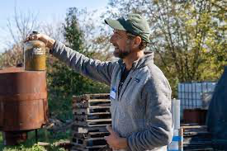
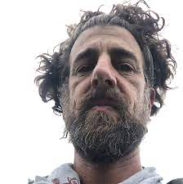
Matt Steiman, Livestock Operations Manager
Matt has been farming organic vegetables since 1993, working on farms in Colorado, California and Minnesota before settling in the Cumberland Valley. For five seasons, Matt managed Fulton Farm at Wilson College where he learned the ropes of running an educational CSA program, and also developed initial experience with renewable energy systems. Matt and Jenn then ran their own farm on rented ground for two seasons before signing on as the full-time farmers at Dickinson College in 2007. In addition to regular farm duties at the Dickinson Farm, Matt supervises equipment maintenance, irrigation, sheep and cattle, and also works extensively with solar energy projects and biodiesel fuel applications for the college.
Notes:
You’ll get to meet Matt in a few week when we visit the farm.
Then he’ll be back later in the semester to answer questions about some of your work.
Then hopefully he’ll join us at the end of the term for your final presentations.

Slide 11

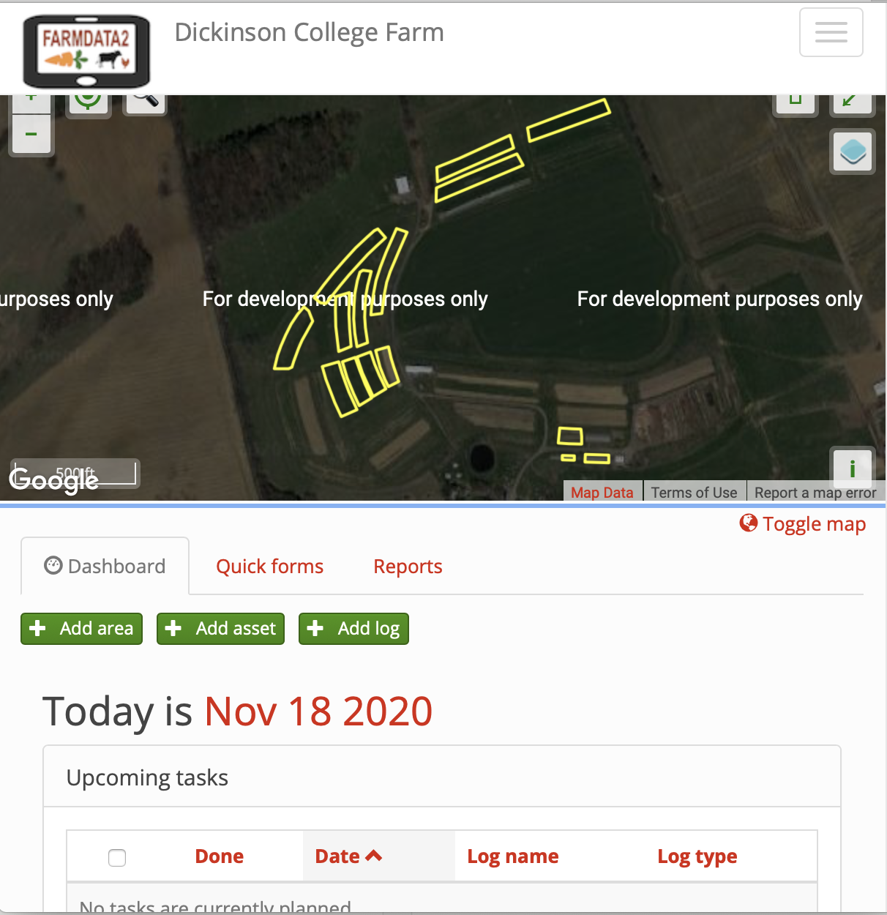
FarmData2
FarmData2 aims to update and combine FarmData and AnimalData, to create a single application that will support the operation and certification requirements for small organic farming operations.
A living FOSS project and community
Notes:
For about 3 years now, the CS department has been working on launching the FarmData2 FOSS project
It is a redesign and combination of FarmData and AnimalData
It is a FOSS project - open to the world.
- Lives on GitHub
- used in COMP 190 (as you know)
- at the center of this course
- Supports summer Software Development Internships
- typically 2 each summer (possibly not in 2023 though :(
- keep an eye open for the advertisement for those
- Academic year developer positions
- 1 or 2 per semester
- But FarmData2 is also a living FOSS project and community
- have had some developers from around the world chip in with contributions
- working toward engage students/courses from other colleges with organic farms as well.

Slide 12
FarmData2 Technology
FarmData2 is a modern web application:
Docker Containers
HTML/CSS/Javascript
Bootstrap
Vue.js
Cypress Testing
Express API
Notes:
This class will get you prepared to contribute to FarmData2:
It is built a modern front end development stack
- good experience for you
You will be learning and using some of the following technologies…
- If don’t know these… no worries… this class introduces everything you need to know.
- If you know some already from another class...
- No worries… you’ll get a little review and hopefully learn a little bit more.
Some may wonder why Vue:
- Vue is easier to learn than Angular or React.
- Fits better as a part of other applications
- Rather than taking over the entire application.
- Vue has a conceptual overlap with Angular and React with respect to the functionality like the use of components.
- What you learn about Vue will largely transfer to Angular and React.
- But because those have stringent ways of organizing the projects the opposite is not as true.

Slide 13

Activity 01 – FarmData2 Developer Install
Goal: Get FarmData2 Up and Running
Activity Sheet will guide you, but you will be making use of the project documentation.
Uses git / Docker Desktop / TigerVNC Viewer (as in 190).
Use the fork: https://github.com/DickinsonCollege/FD2School-FarmData2
Ask questions on Zulip.
Install Stream
FarmData2 School Stream
Notes:
Should be time to get started in class.
Most important thing here is to use the FORK!!
- Use FD2School-FarmData2
- This means that your practice pull requests will go to this fork and not to the main project repo.
- Good practice for you
- Doesn’t interfere with the main project development.
We will transition to the main project repo when we get to the project work
- Then you will make PR’s to the main upstream.

Slide 14
What’s Next
Read Syllabus
Ask questions on Teams
Bring questions next time
Activity 01
Due next Wednesday 12:00 pm
Reading Assignment
Have one thing you found interesting ready to raise for discussion during next class.
Notes:
Use remaining class time to get started.

Slide 15

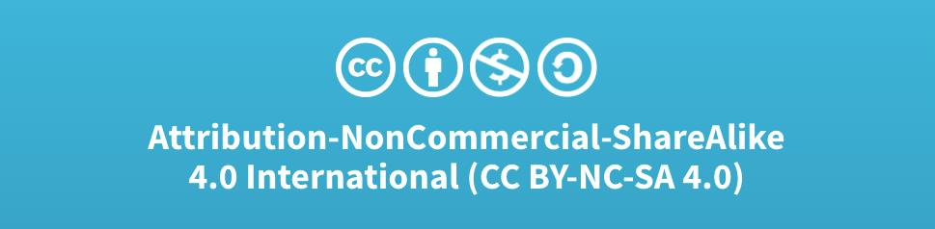
Acknowledgments:
Slide Template From:
https://creativecommons.org/licenses/by/4.0/
Slide Content Licensed as:
Creative Commons Attribution-NonCommercial-ShareAlike 4.0 International License.

